Slide 1
Comparison of measures of adherence to HIV pre-exposure prophylaxis (PrEP) among men who have sex with men (MSM) and transgender women (TGW): results from the PrEP Brasil study (TUAC0303)
Luana M.S. Marins, Thiago S. Torres, Iuri da C. leite, Ronaldo I. Moreira, Brenda Hoagland, Esper G. Kallas, José Valdez Madruga, Peter L. Anderson, Albert Y. Liu, Beatriz Grinsztejn, Valdilea G Veloso
Tuesday, 24 July 2018

Slide 2
Disclosure
Gilead Sciences donated the study drug and covered costs related to drug concentration assessment, but had no role in study design, collection, analysis, and interpretation of data, writing of the abstract, or the decision to submit the abstract for presentation.

Slide 3
Background
Truvada (FTC/TDF) for PrEP: significant reduction in the risk of HIV acquisition.
Levels of protection are directly proportional to adherence.
Anderson, P. L. et al. Sci. Transl. Med. 4, 151ra125 (2012).
Amico, K. R. et al.. JAIDS 66, 530–537 (2014).
Zheng, J.-H. et al. J Pharm Biomed Anal 122, 16–20 (2016).
Marcus, J. et al. HIV Medicine 15, 385–395 (2014).

Slide 4
Effectiveness of TDF/FTC PrEP Improves With Adherence
100
PROUD^{[6]} Efficacy 86% Adherence ~ 100%
Partners PrEP^{[5]} Efficacy 75% Adherence 81%
80
60
Effectiveness (%)*
TDF2^{[4]} Efficacy 62% Adherence 80%
40
iPrEx^{[3]} Efficacy 44% Adherence 51%
20
VOICE/FEM-PrEP^{[1,2]} Efficacy 0%/6% Adherence 29%/≤ 37%
Slide credit: clinicaloptions.com
0
0
20
40
60
80
100
*Reduction in HIV incidence vs control. †Based on pill counts or the detection of study drug in plasma.

Slide 5
Goal of this Study
We examined the concordance between three adherence measures in relation to protective drug levels among participants at week 48 in the PrEP Brasil Study.

Slide 6
PrEP Brasil Demostration Study
Prospective, multicenter, open-label demonstration study
MSM and TGW at higher risk for HIV infection (48 Weeks)
Brazilian Public Health System context
Conducted at three reference centers for HIV prevention and care

Slide 7
Adherence Measures
Estimates of pill used assumed that all pills were taken from unreturned bottles.
Pill count: number of tablets dispensed in prior visit minus tablets returned at study visit, divided by the days between the two visits (90-days).
Self-report: in-person interview (30-days recall)
MPR: ratio of days “covered” by a dispensation relative to the total number of days between visits (90-days)
MPR values ≥ 1.00 indicate 100% coverage or higher
MPR < 1.00 reflect days uncovered by study drug.

Slide 8
TFV-DP levels
DBS were collected for TFV-DP assessments from all participants
TFV-DP were measured using LC-MS/MS at the University of Colorado Antiviral Pharmacology Laboratory (USA) with standard procedures
TFV-DP in DBS has a half-life of 17 days
Anderson, P. L. et al. Sci. Transl. Med. 4, 151ra125-151ra125 (2012).
Castillo-Mancilla, J. R. et al. AIDS Res. Hum. Retroviruses 2, 384-390 (2013).
Grant, R. M. et al. The Lancet Infectious Diseases 14, 820–829 (2014).
Zheng, J.-H. et al. J Pharm Biomed Anal 122, 16–20 (2016).

Slide 9
Adherence interpretation from drug level data
TVF-DP Concentration (fmol/punch) | PrEP intake
< 350 fmol/punch | < 2 doses/week
≥ 350-699 fmol/punch | 2-3 doses/week – Protective level
≥ 700 fmol/punch | ≥4 doses/week – Highly Protective level (High Adherence)
Anderson, P. L. et al. Sci. Transl. Med. 4, 151ra125 (2012).
Grant, R. M. et al. The Lancet Infectious Diseases 14, 820–829 (2014).

Slide 10
Statistical Analyses
Areas under the ROC curve (AUC) ►Measure of accuracy
Youden index and distance to corner ► Optimal cut off
PPV/ NPV ►Concordance between measures
DeLong test ►Verify whether the curves are different from each other.
Notes:
The receiver operating characteristic (ROC) curve and the area under the curve (AUC) is an effective measure of accuracy, which plays a central role in evaluating diagnostic ability of tests to discriminate the true state of subjects.

Slide 11
Results – Adherence Measures
375/450 (83%) Participants retained through 48 weeks
High Adherence at week 48 (drug level) : 277/375 (74%)
 | MPR (n=375) | Pill count (n=333) | Self-report (n=347)
Median adherence (IQR) | 1.1 (0.98-1.3) | 97.1 (88.89-100.0) | 100.0 (93.3-100.0)

Slide 12
Accuracy of the Adherence Measures
0.90-1 = excellent
0.80-0.90 = good
0.70-0.80 = fair
0.60-0.70 = poor
0.50-0.60 = fail
Adherence measures | AUC (95%CI) | P-value
MPR | 0.70 (0.63-0.76) | <0.0001
Pill count | 0.68 (0.60-0.76) | <0.0001
Self-report | 0.65 (0.58-0.72) | <0.0001
iPrEx placebo-controlled trial (AUC):
MPR: 0.64 (0.59–0.69)
Pill Count: 0.49 (0.44–0.54)
Self-report: 0.51 (0.46–0.56)
Amico, K. R. et al.. JAIDS 66, 530–537 (2014).

Slide 13
Other Open Label Studies
Partners PrEP Ancillary Adherence Study (AUC) - Plasma ¹
Self-report (%): 0.5375
Pill Count (Unannounced): 0.5308
PrEP in “real-world” clinical settings in the US (AUC) - DBS ²
Self-report : 0.85
MPR: 0.84
1. Muganzi D, Boum Y, Musinguzi N, et al. CROI; Seattle, Washington. 2015. Abstract 976.
2. Patel, R. et al. Oral abstracts of the 21st AIDS (2017). Abstract WEAC0105

Slide 14
Predictive values
Adherence Measures | Cut off point* | Sensitivity | Specificity | PPV | NPV
MPR | 1.07 | 0.68 | 0.62 | 0.84 | 0.41
Pill count | 90.09 | 0.77 | 0.62 | 0.86 | 0.47
Self-report | 99.90 | 0.64 | 0.56 | 0.84 | 0.31
*Youden index and distance to corner

Slide 15
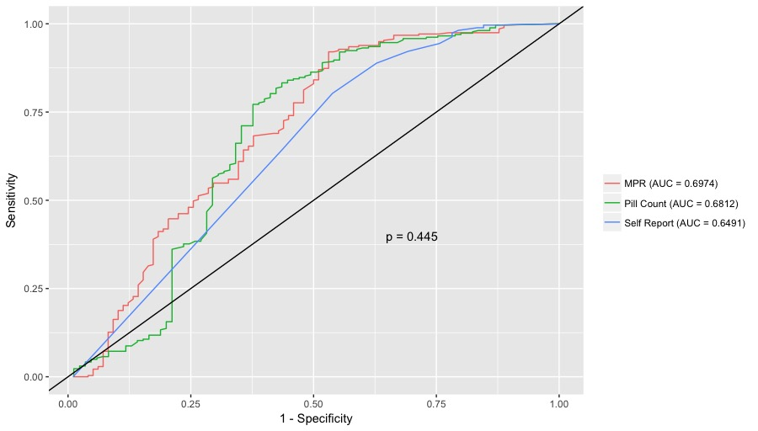
Comparing the performances of the different adherence measures*
*DeLong test

Slide 16
Summary
All adherence measures were able to discriminate between participants with and without protective drug levels (AUC>0.5)
High recorded adherence was predictive of protective drug levels (PPV>0.8)
Low recorded adherence could not predict lack of protective drug levels (NPV<0.5)
Low-burden measurements such as MPR and self-report can be used to predict PrEP adherence in a public health context in Brazil.

Slide 17
Acknowledgements
Study Participants
PrEP Brasil Study Team
University of Colorado Antiviral Pharmacology Laboratory
AIDS 2018 scholarships
CNPq
SVS
FAPERJ
FAPESP
Gilead Sciences

